Slide 1
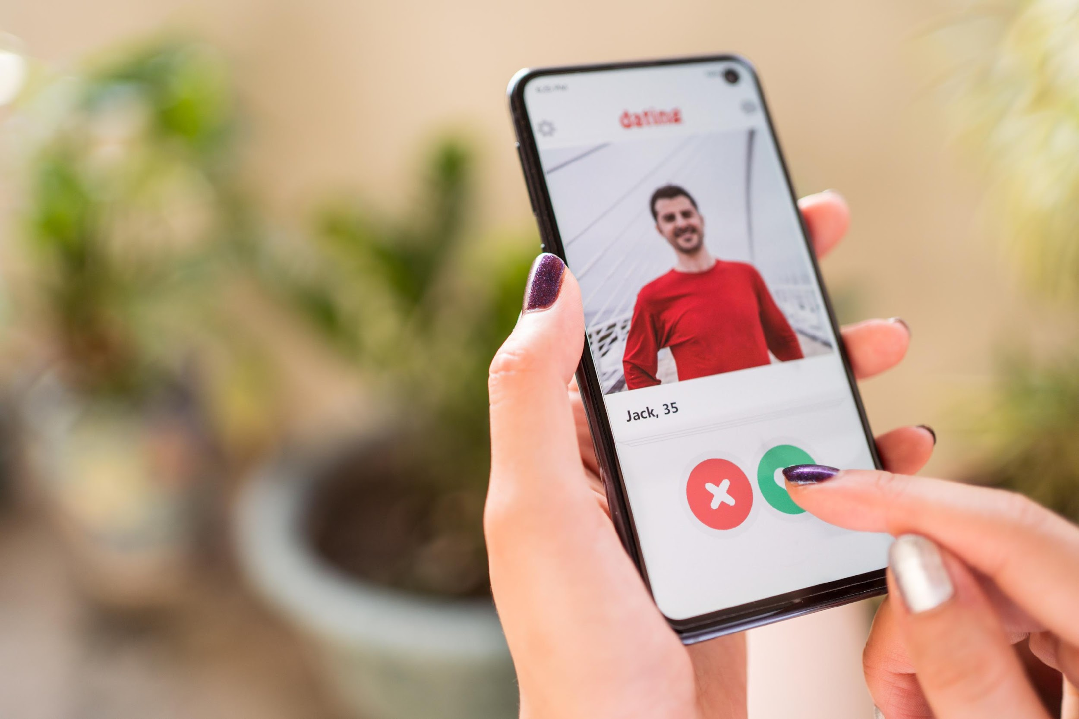
THERAPIZE
Swipe Right to Heal!
Team 1:
Priyanka Jangid
Jeffrey Gao
Shruthi Janakiraman
Milouni Sheth

Slide 2

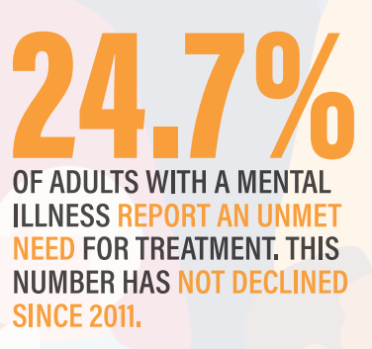
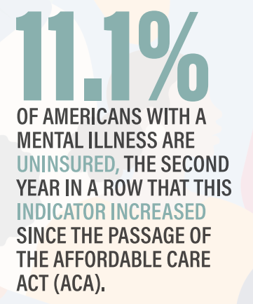
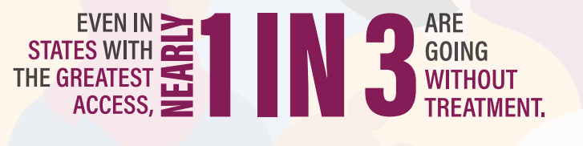
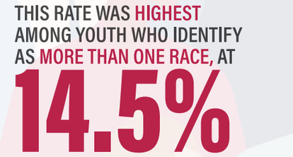
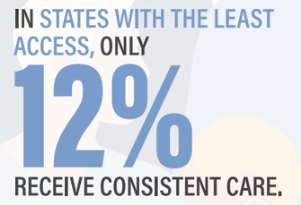



The Problems
The gaps between prevalence and utilization data
Reasons for these barriers
Lack of awareness and
information
Cost and Insurance
Lack of access to diverse
mental health practitioners

Slide 3
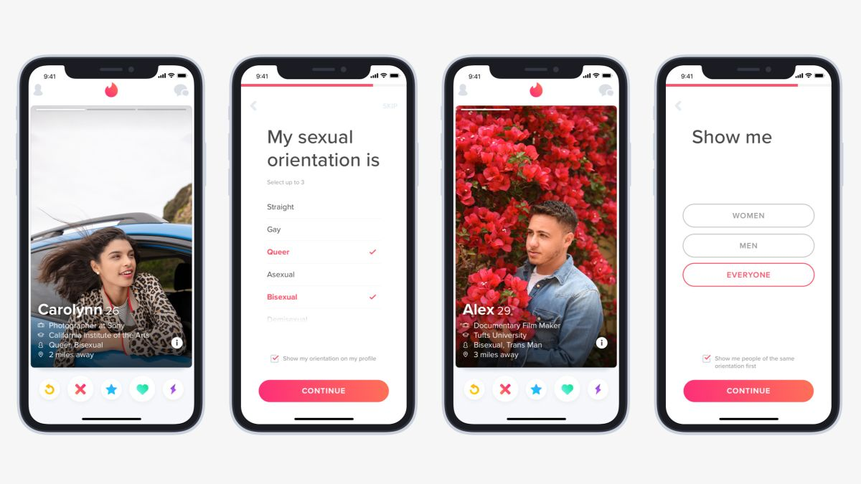
The Solution
Lack of Awareness and Information
Therapize for clients:
Swipe right on therapist profiles that meet your needs
Filter demographic details and distance to find your ideal match
Schedule appointments once swiped right
A one stop repository for all private and public mental health practitioners. Prompts to get to know them.
Cost
Clearly called out costs on the therapist’s profile. Filter to set cost criteria.
Lack of access to diverse mental health practitioners
Therapize for therapists:
Add a business avenue while helping people in need
Have a visibility into your schedule with automatic appointment scheduling
Filters include race, gender, age, speciality and distance.

Slide 4
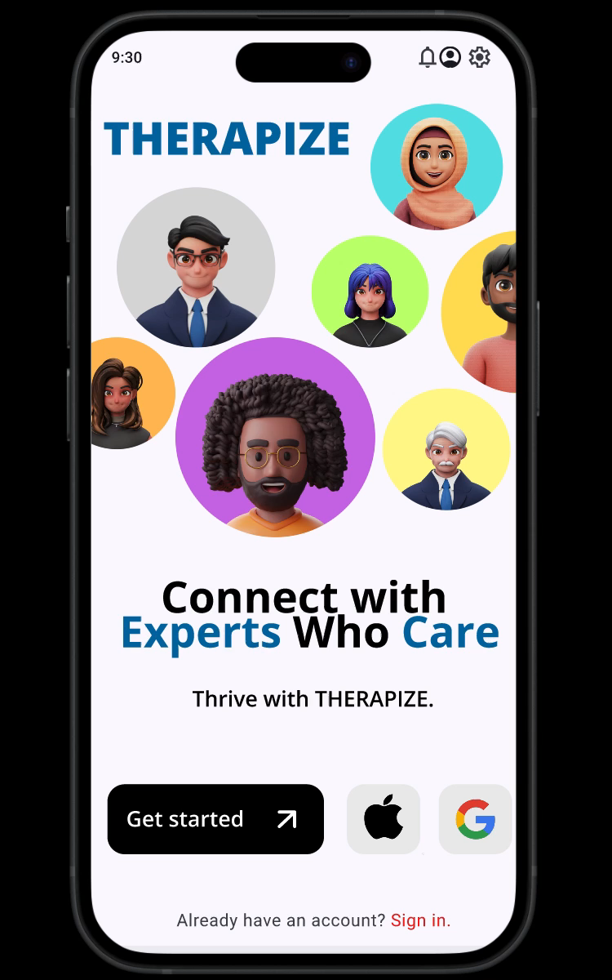
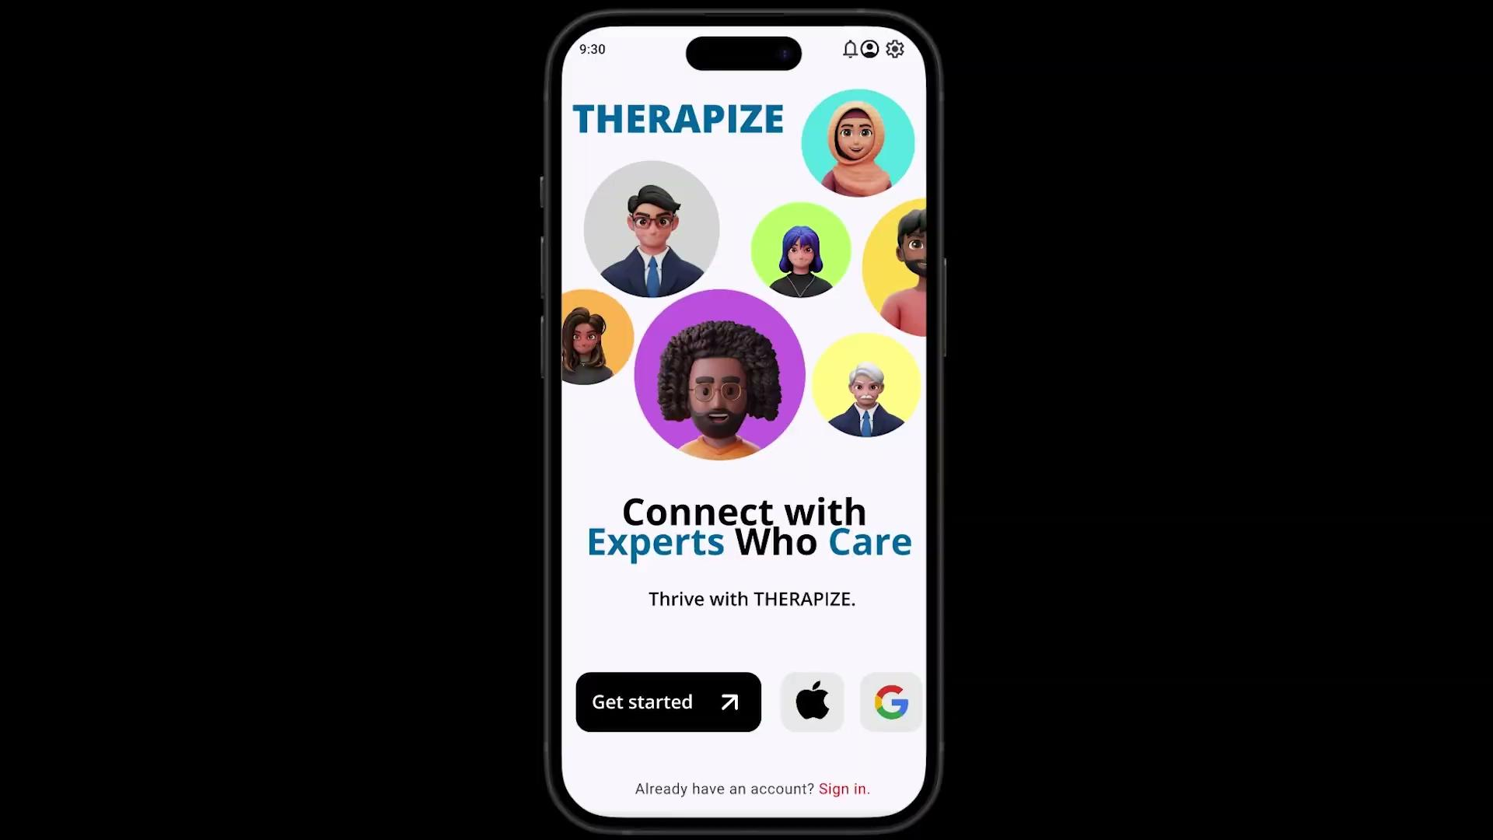
The Prototype App - Demo
Lack of rmation

Slide 5
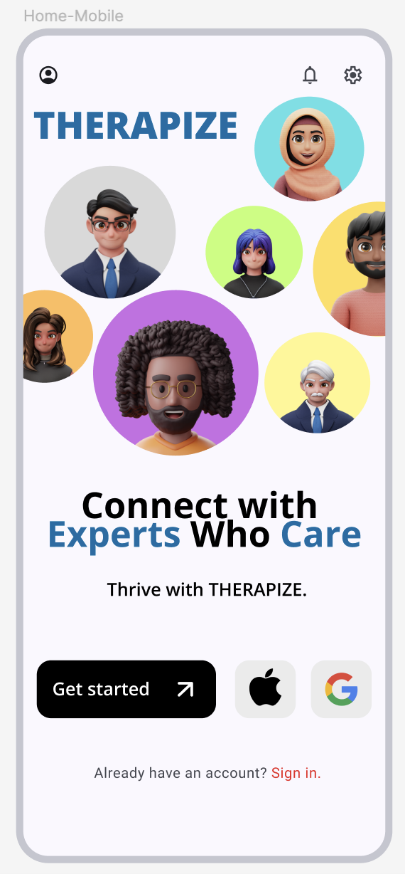
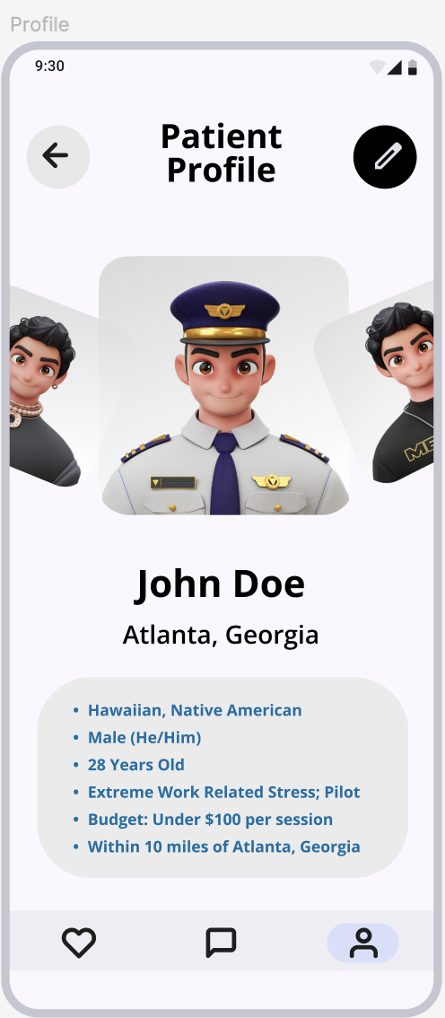
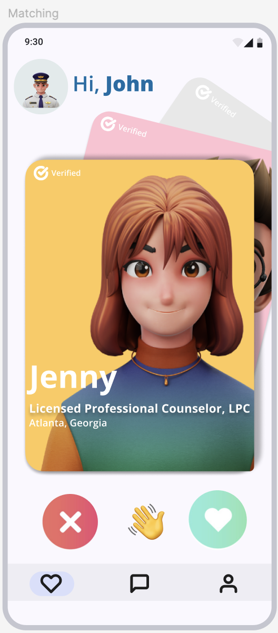
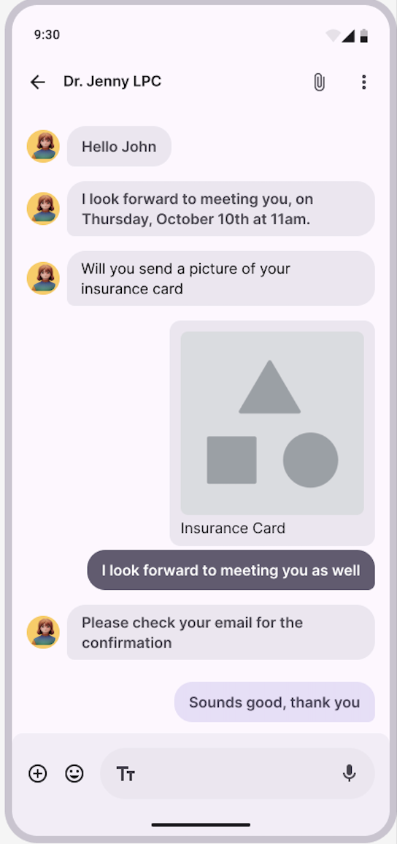
The Prototype App
Lack of rmation

Slide 6
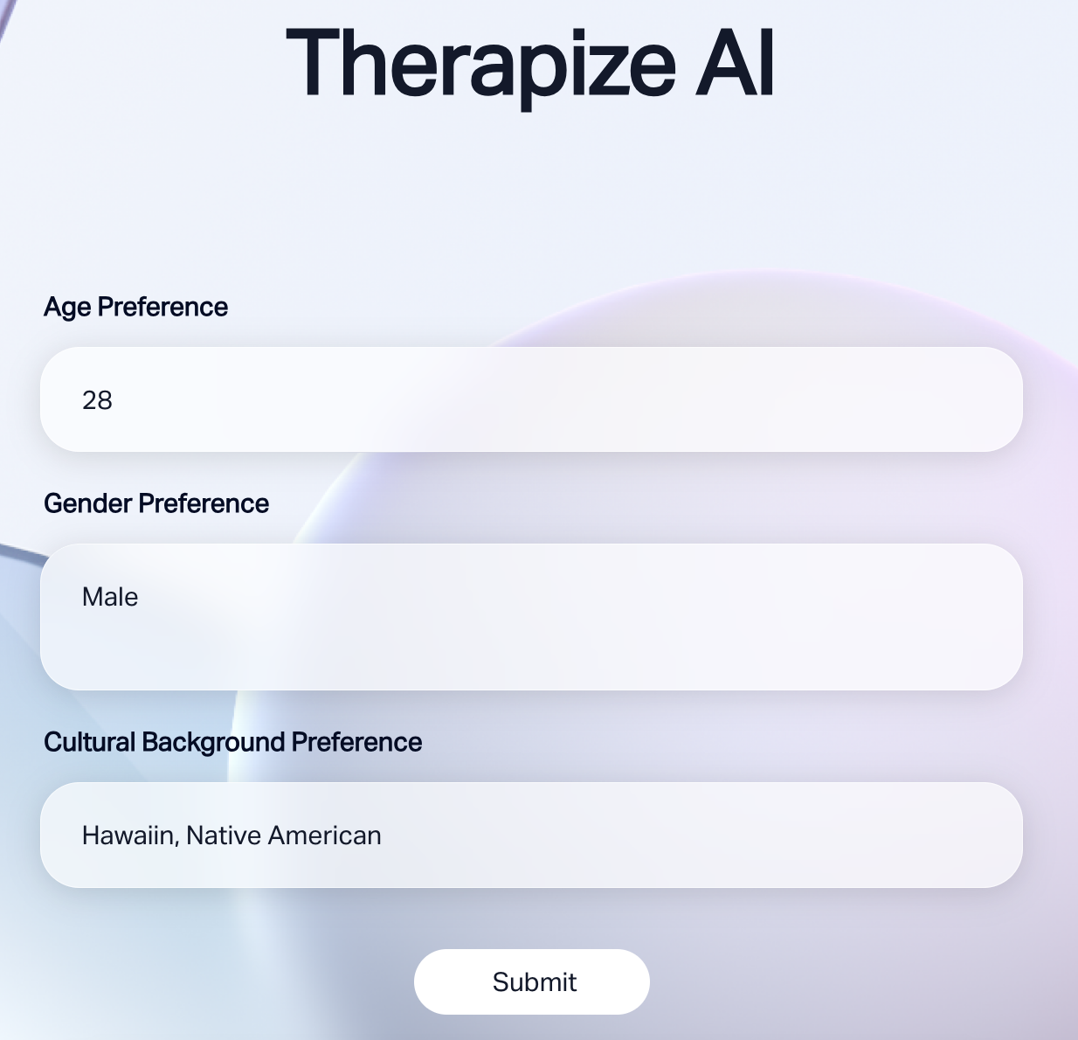
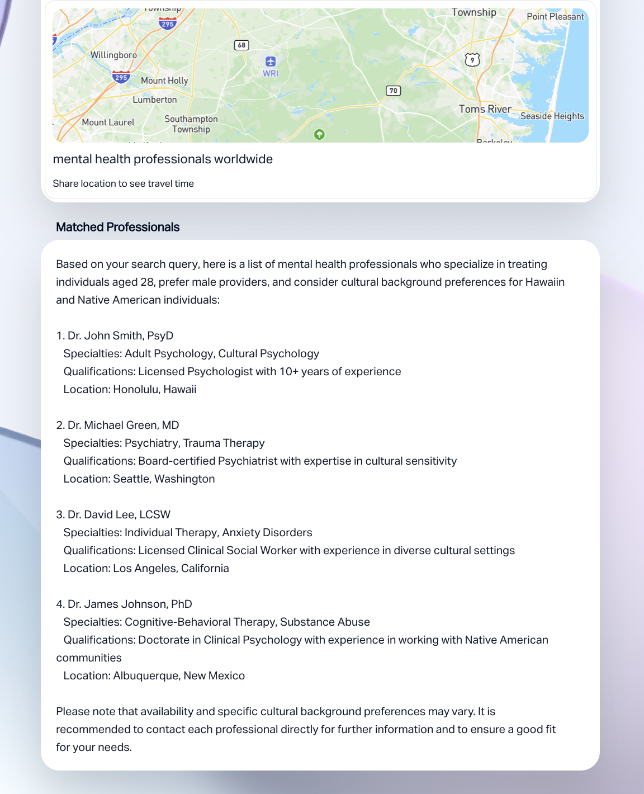
Value Proposition - AI-Driven Matching Algorithm

Slide 7




Target Market
CLIENT
CLIENT AND THERAPIST
CLIENT AND THERAPIST
THERAPIST
Gen Z or Millennial adults seeking therapy based on specific criteria
Licensed therapists, specially those representing minority populations.
Residing in Utah, Oregon, Montana, Wyoming, Colorado
Conscious consumers who are tech-savvy, value flexibility & hyper personalization

Slide 8
Market Analysis
Competitive Advantages over BetterHelp and TalkSpace
Identity Based Therapy Matching
More than 1 in 5 US Adults live with a mental illness
Global Mental Health Market is valued at $412 Billion in 2023 ($567 Billion by 2032)
The teletherapy market valued at $6.5 Billion in 2023, expected to grow rapidly
1
Comprehensive Matching Algorithm, Unique AI matching, Diverse Therapist base
2
Familiar User Interface
Engaging User Experience, easy Swipe Right functionality
3
Scalability
First Mover Advantage, Adaptive Technology, Relevant across countries & cultures

Slide 9
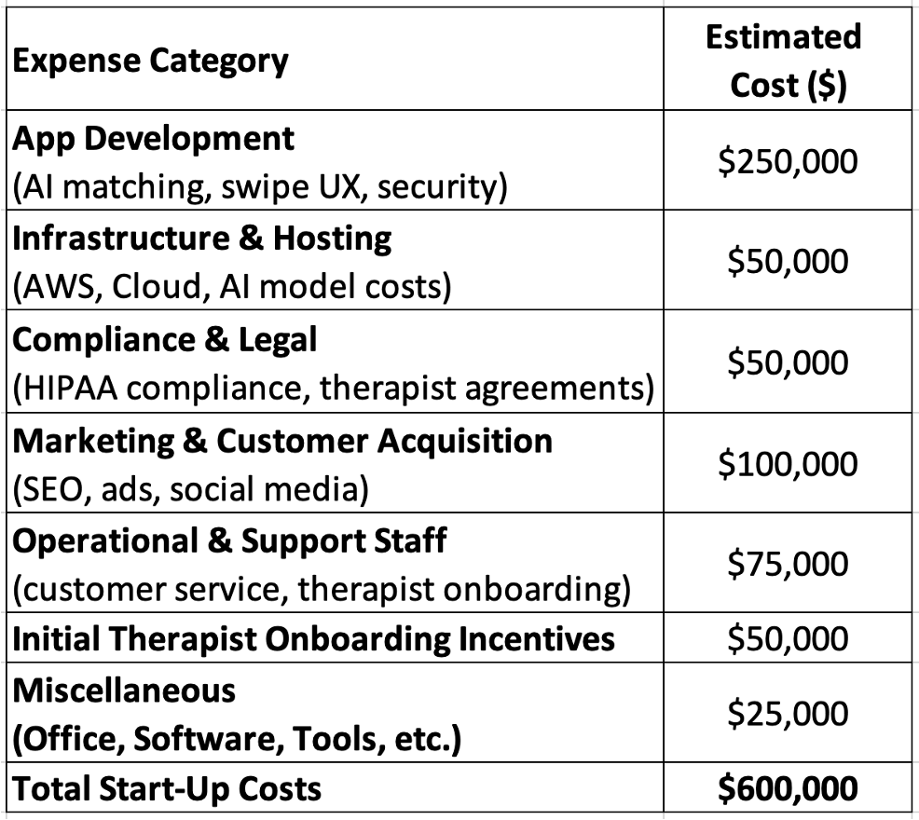
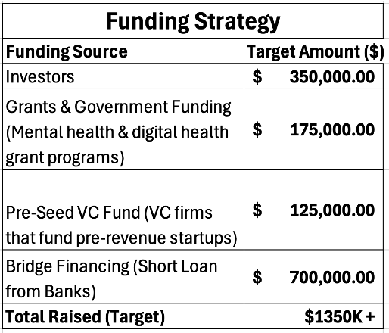
Projected Startup Costs
*AI help taken

Slide 10
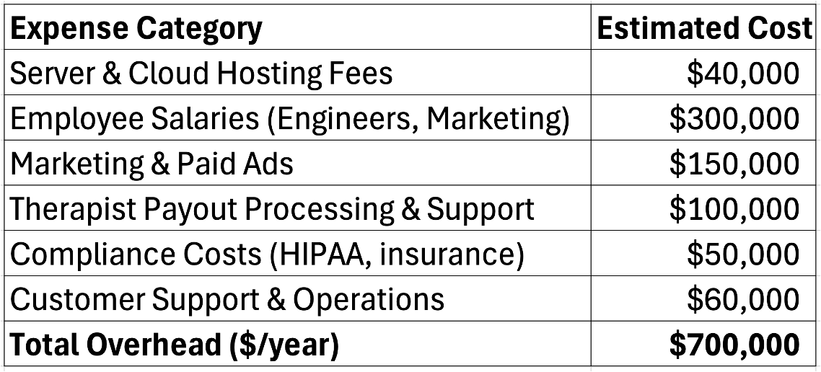
Annual Overhead Costs

Slide 11

Revenue Model & Pricing Strategy
Freemium Model for Clients | Subscription Plans for Therapists | Additional Revenue Streams
Free access to therapist matching & limited filters | Basic (Free): Standard visibility | One-time Booking Fees (10%) per session
Premium subscription ($15.99/month) for unlimited swipes, filters & AI-matching | Premium ($49/month): Enhanced visibility | B2B Corporate Partnerships with insurance & HR wellness programs
 | Enterprise ($99/month): Full analytics & priority ranking | In-App Advertising for mental health & wellness brands

Slide 12

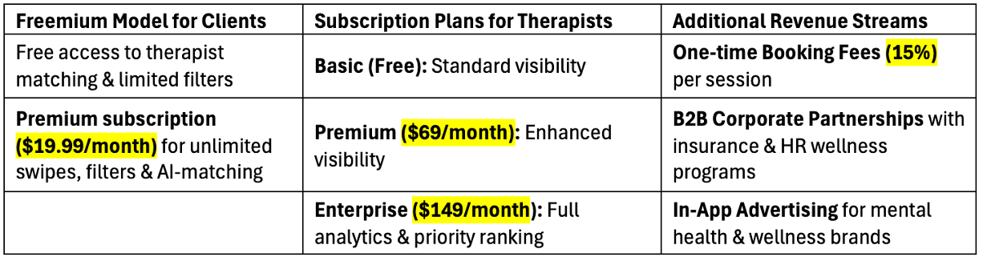
Revenue Model & Pricing Strategy

Slide 13
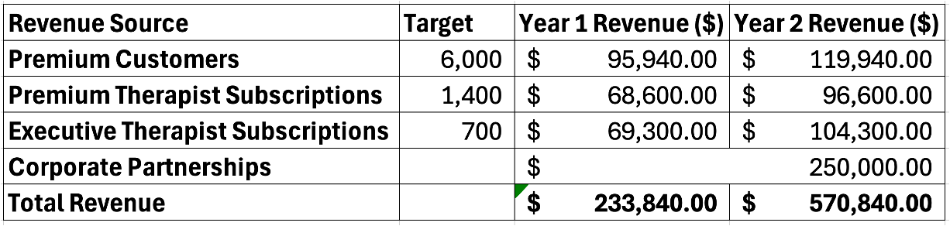
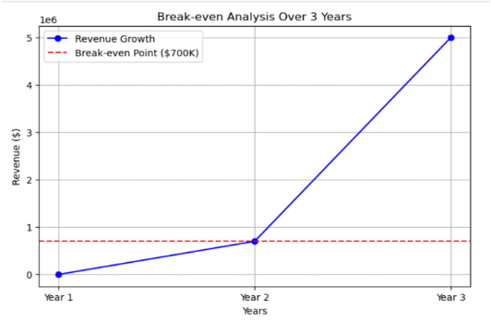
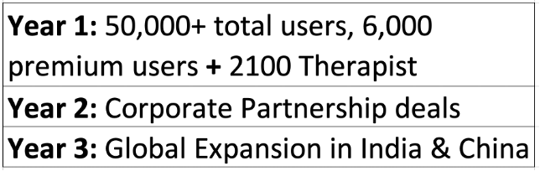
Break-Even Revenue Target

Slide 14

PESTEL
Political: Healthcare Policies and Licensing
Economics: Insurance trends and job market trends
Sociocultural: Behavioral and lifestyle changes
Technological: Technology advancements
Legal: Following laws and HIPAA
Notes:
we must follow healthcare policies and licensing laws. Therapists need proper certification
Facts like insurance and job market trends affect whether individuals can afford therapy.
Mental health awareness is increasing, and more people are open to therapy, especially online solutions.
Especially since we are AI driven it is really important to us that we keep up with improving out technology as it expands
Since we handle health sensitve data its really cruicial that we abide to hipa laws to keep our patients info private

Slide 15
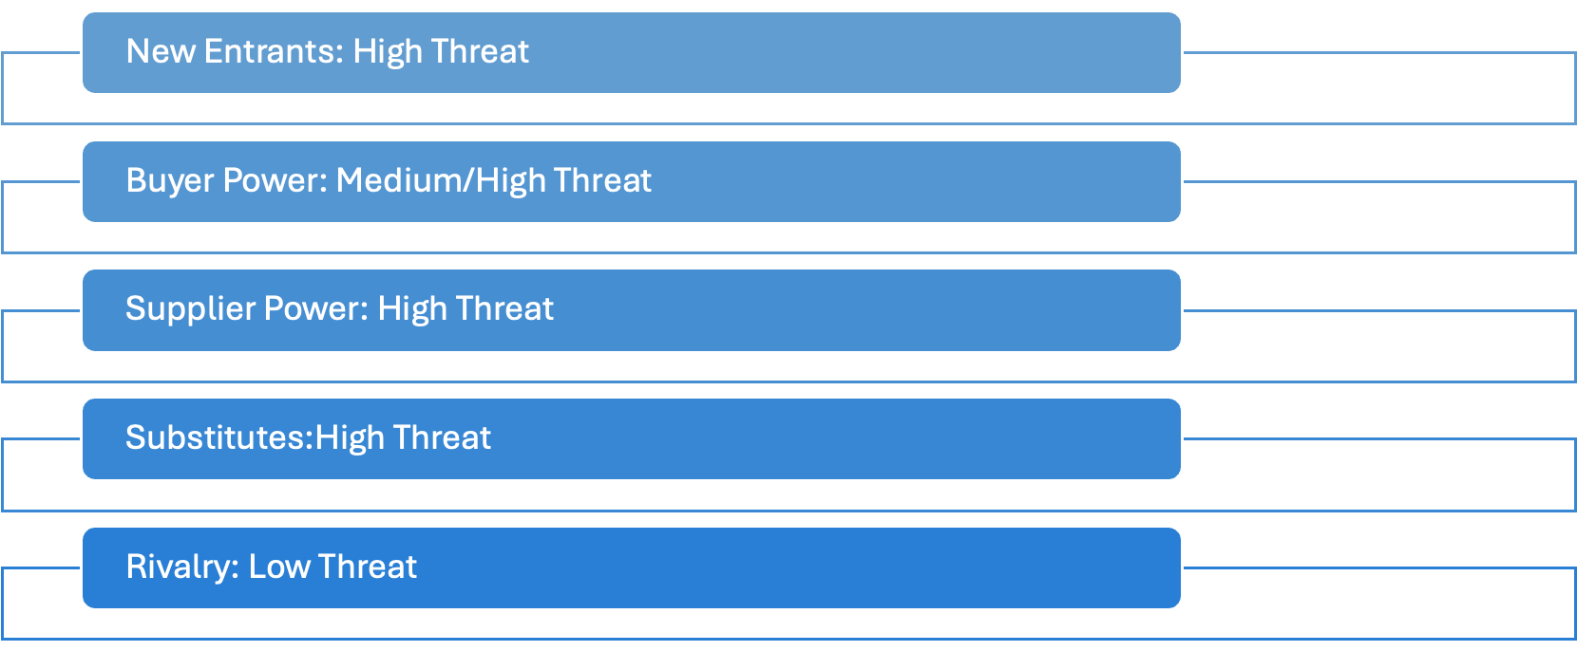
Porter’s 5 Forces
Notes:
New entrants are a high threat because new Competitors can replicate our AI-driven therapist matching and add similar features.
Buyers can easily switch over to other services or even a traditional therapist just based on prices and quality
Supplier Power is gonna be a high threat because our suppliers are obviously our therapist and their availability is vey cruicial for our platform
Substitutes is a high threat because There are alternatives like AI-driven therapy chatbots, self-help apps, and traditional therapy options. These substitutes could take potential users away from our platform.
Rivalry: Even tho we do have competition our technology and Ai driven approach gives us a unique edge over our competitors

Slide 16

SWOT Analysis
Strength: AI-Driven Matching Algorithm, User-friendly interface, Freemium model
Weakness: Limited brand recognition, resource constraints, reliance on therapists’ availability
Opportunities: Teletherapy market expansion, partnerships with insurance companies, corporate wellness programs
Threats: Regulatory challenges, technological risks, economic downturns

Slide 17
Strategic Plan - The Why
Differentiation through First Mover advantage
01
Seek investments and Strategic Partnerships
02
Rapid Market Penetration and Brand Building
Scale operations by securing funding to develop resources and capabilities.
Exclusively Partner with therapists to ensure that a diverse and vetted network is available to users on the app
Scale by acquiring a solid customer base and acquire market share
Position as leader in this niche space by building brand identity and customer education
03
Customer loyalty through innovation
04
Achieve Regulatory Compliance, Trademarks, Build Technological Infrastructure
Ensure customer retention and loyalty through introducing new app features, personalization, enhanced experience and integrating feedback
Generate a steady stream of revenue
Protect the app’s unique value proposition by applying for trademarks
Increase customer trust and credibility by adhering to mental health laws and regulations

Slide 18
Strategic Plan - The How
Differentiation through First Mover advantage
01
Seek investments and Strategic Partnerships
02
Rapid Market Penetration and Brand Building
Engage with angel investors and startup incubator cells, especially in the mental health space. Offer early join in offers to therapists, group benefits for clinics and ensure exclusive partnerships
Run dedicated digital campaigns and targeted ads, partner with mental health influencers, engage in community outreach programs, offer premium features free for disadvantaged populations
03
Customer loyalty through innovation
04
Achieve Regulatory Compliance, Trademarks, Build Technological Infrastructure
Ensure customer retention through new features, premium modes, and in-app purchases. Introduce a strong referral program. Expand into new revenue streams such as corporate partnerships, admin features and telehealth options.
File patent for unique algorithm, trademarks for branding. Obtain HIPAA certification, ensure data implementation of data encryption and privacy regulations
*AI aid for regulatory and investment implementation ideas

Slide 19


Slide 20
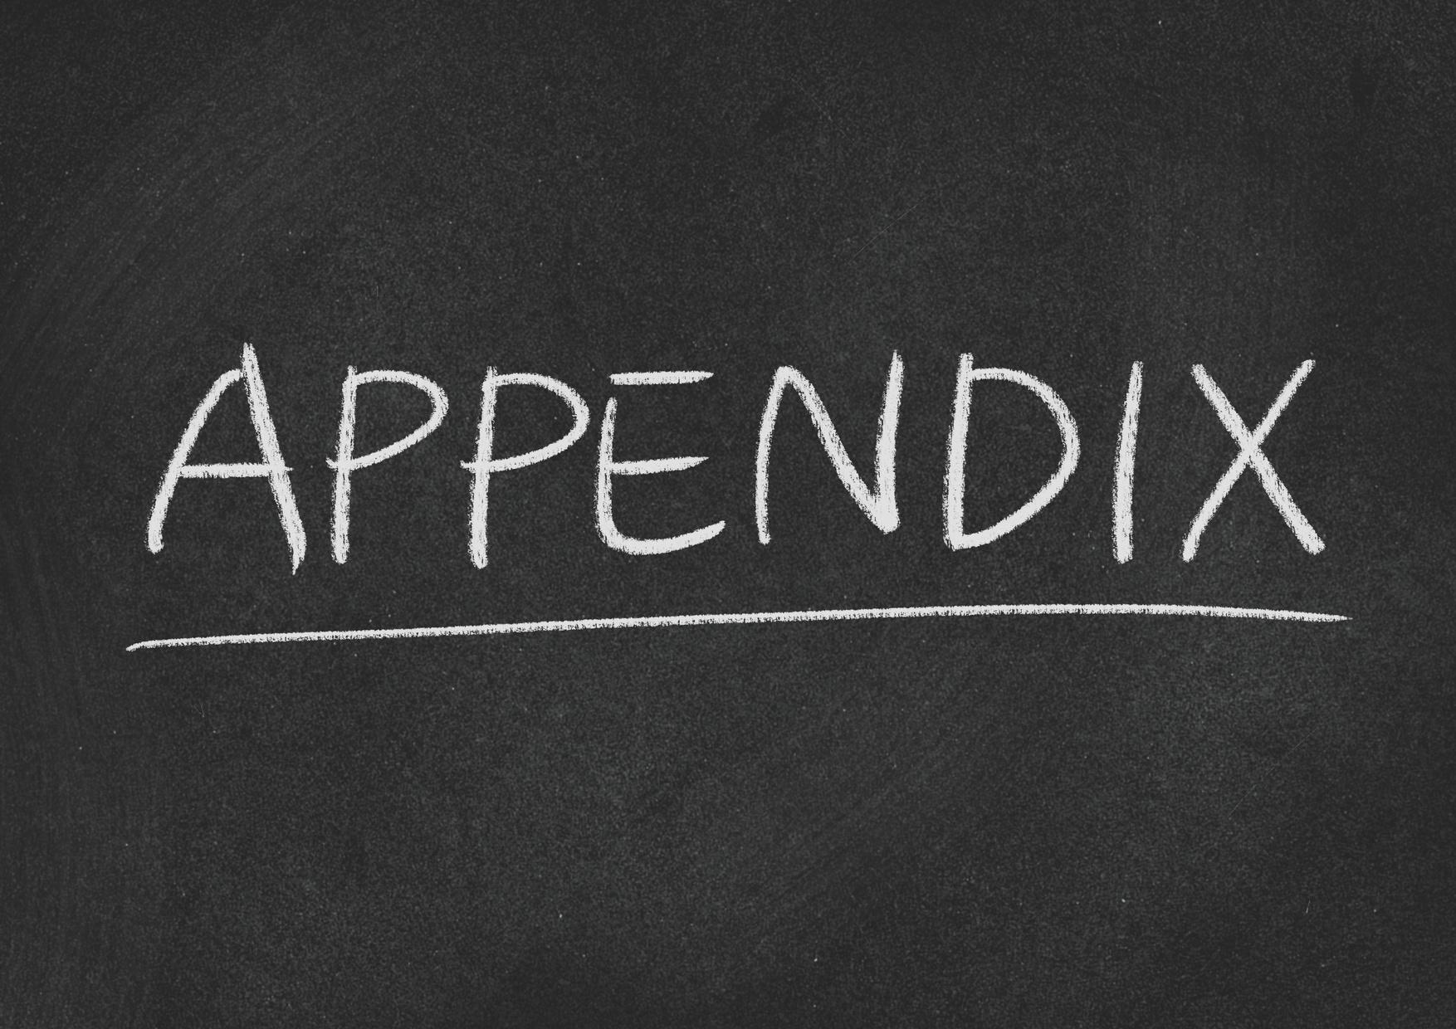

Slide 21
PESTEL
Dimension | Support
Political | shifting within the political focus in healthcare, potential labor laws shifting within the healthcare industry
Economic | Job market trends and income levels can affect one's need for therapy
Sociocultural | Behavioral and lifestyle changes. Awareness of mental health has been increasing over the years making it more popular along with telehealth it has been more popular over the years making therapy more easier and accessible for consumers
Technological | Technology is constantly evolving so its important for us to keep up with and make sure to integrate it within our app especially since out company is very Ai and technologically focused
Legal | The laws and regulations especially towards HIPA by making sure everything is done to the book especially through the app it is important that the patients information is protected and kept safe

Slide 22
PORTER’S FIVE FORCES
Dimension | Threat Level | Support
New entrants | Low / Med / High | Potential new therapy practices can replicate our Ai practices and integrate technology more into their systems as well
Buyer power | Low / Med / High | Buyers can easily switch over to other services or even a traditional therapist just based on prices and quality
Supplier power | Low / Med / High | Dependant on therapists availability
Substitutes | Low / Med / High | Similar platforms that our consumers could switch over to are Better Help and Talk Space. They can duplicate our Ai algorithms to use
Rivalry | Low / Med / High | Therapize differentiates itself with its use of AI to better match patients with therapists. Our platform is also a more simpler user friendly for patients to take part in to find the perfect therapist for them

Slide 23
SWOT Analysis
Strength: AI-Driven Matching Algorithm - Therapize uses a unique AI-driven matching algorithm to connect clients with therapists based on identity, preferences, and needs, offering a personalized experience. User-Friendly Interface: The app features a swiping functionality, similar to popular dating apps, making it intuitive and engaging for users. Freemium Model: The freemium model for clients and subscription-based fees for therapists create a scalable revenue stream while attracting a broad user base. | Weakness: Limited Brand Recognition: As a startup, Therapize may struggle with brand awareness compared to established competitors like BetterHelp and TalkSpace. Resource Constraints: Being a startup, Therapize may face financial and operational limitations in scaling quickly or marketing aggressively. Reliance on Therapists' Availability: Limited therapist participation may impact user experience.
Opportunities: Teletherapy Market Expansion: The teletherapy market is expected to grow rapidly, driven by increased demand for remote mental health services. Partnerships with Insurance Companies: Collaborating with insurance providers could reduce cost barriers for clients and increase adoption. Corporate Wellness Programs: Partnering with companies to offer Therapize as part of employee wellness programs could open a new revenue stream. | Threats: Regulatory Challenges: Compliance with mental health regulations and data privacy laws (e.g., HIPAA in the U.S.) could pose challenges. Technological Risks: Cybersecurity threats or data breaches could harm user trust and the platform’s reputation. Economic Downturns: Economic instability may reduce discretionary spending on mental health services, impacting revenue.

Slide 24
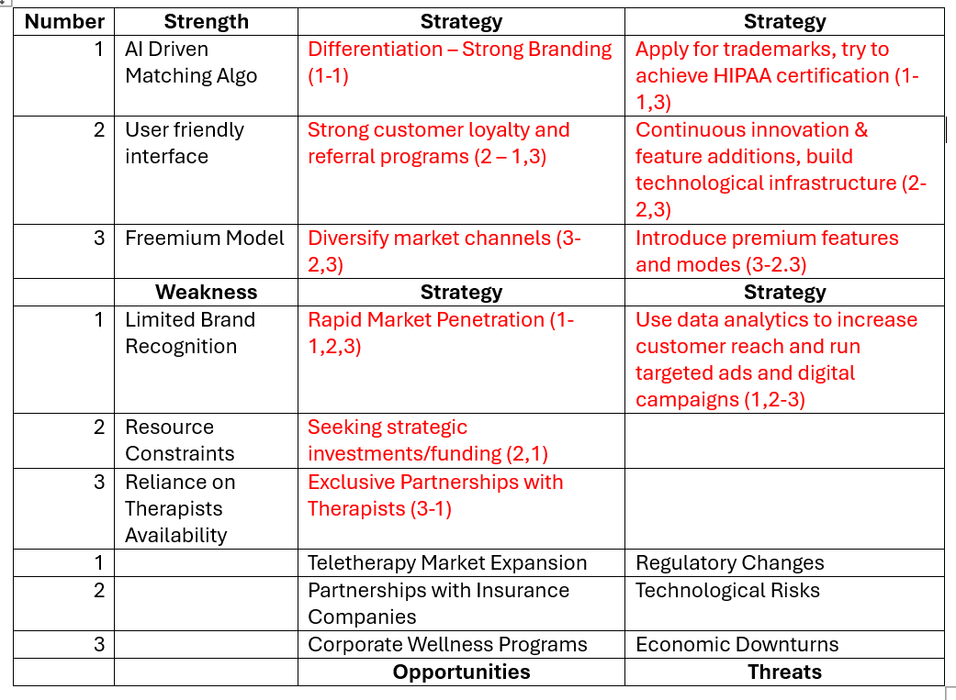
A Detailed Strategy

Slide 25
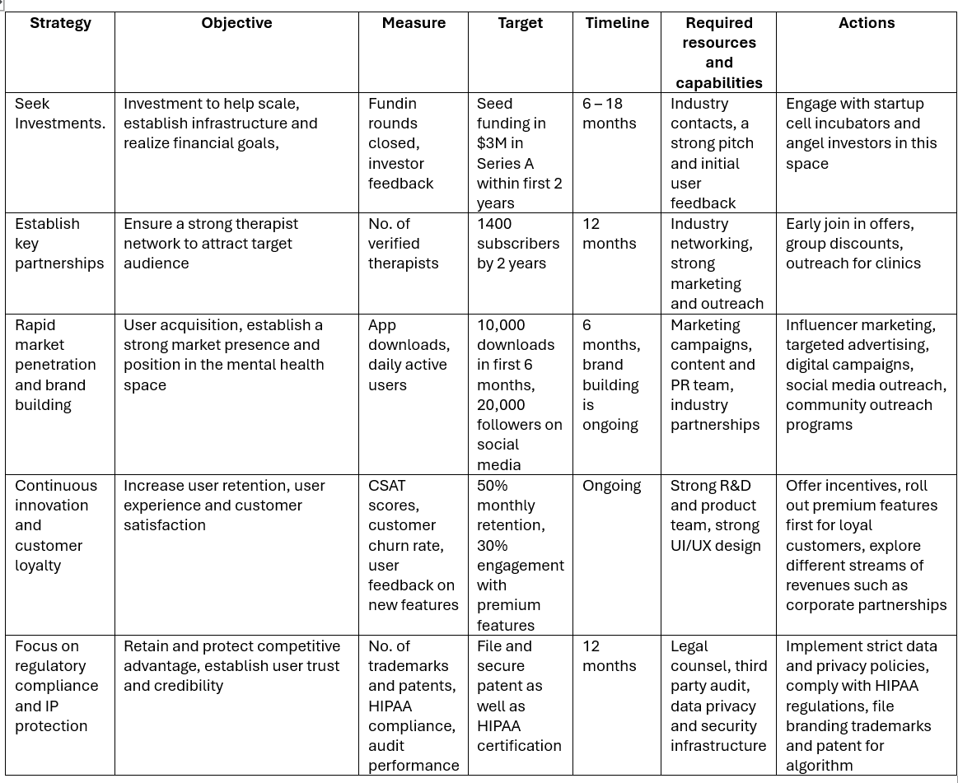
Implementation Support Table
*AI aid for certain aspects of the table such as measures and resources/capabilities

Slide 26
References:
Talkspace Therapy
Betterhelp Therapy
Telehealth Market Size
HIPAA Security Rule
https://mhanational.org/ (https://mhanational.org/sites/default/files/2022 State of Mental Health in America.pdf)
https://www.hhs.gov/about/news/2024/07/30/samhsa-releases-annual-national-survey-drug-use-and-health.html
https://www2.deloitte.com/us/en/insights/industry/health-care/economic-burden-mental-health-inequities.html
https://www.datafiles.samhsa.gov/dataset/mental-health-client-level-data-2022-mh-cld-2022-ds0001
https://www.nimh.nih.gov/health/statistics/mental-illness
https://www.globenewswire.com/news-release/2024/07/10/2911387/0/en/Mental-Health-Market-Size-to-Hit-US-566-07-Billion-By-2032-With-CAGR-of-3-20-Driven-by-Raising-Prevalence-of-Mental-Disorders-Research-by-SNS-Insider.html

